Slide 1


Experiment Visualization Tool
UCSC Capstone Project
Spring Quarter, May 2025

Slide 2

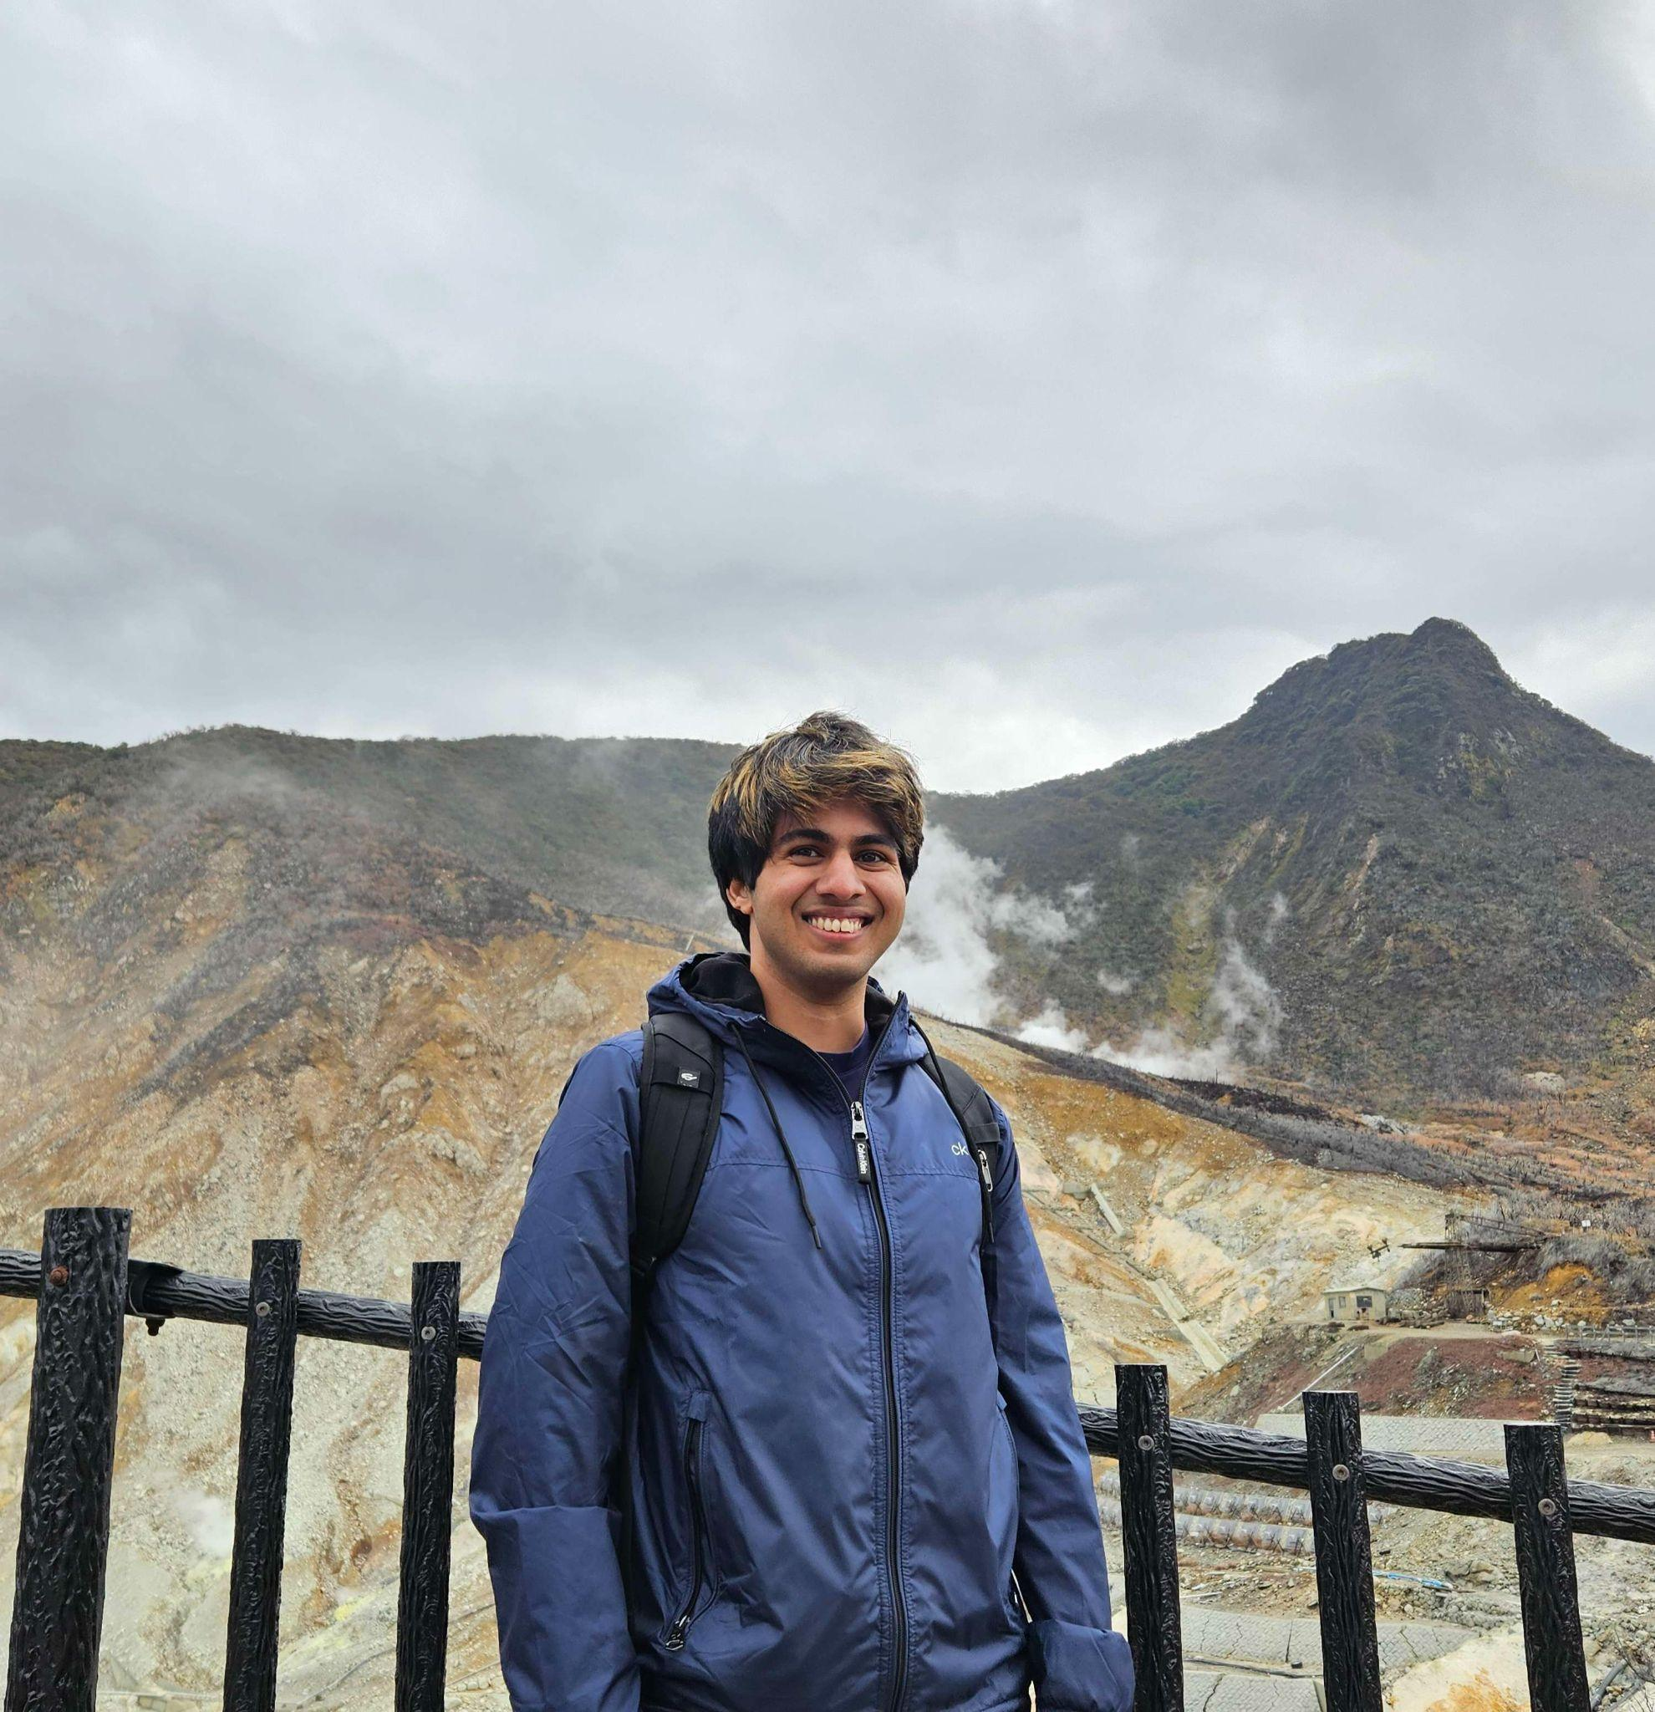
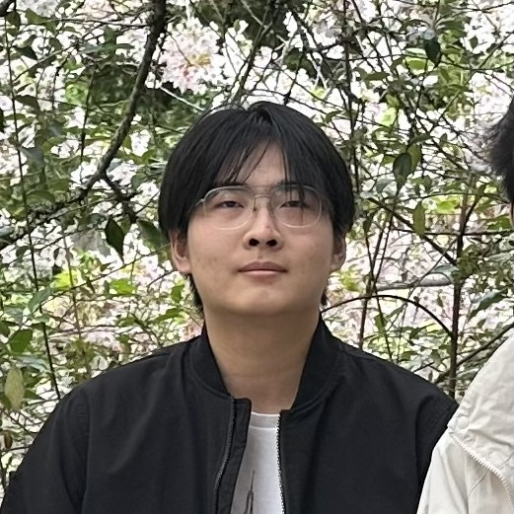
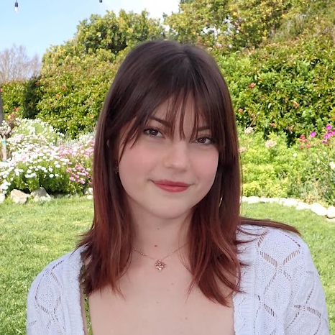
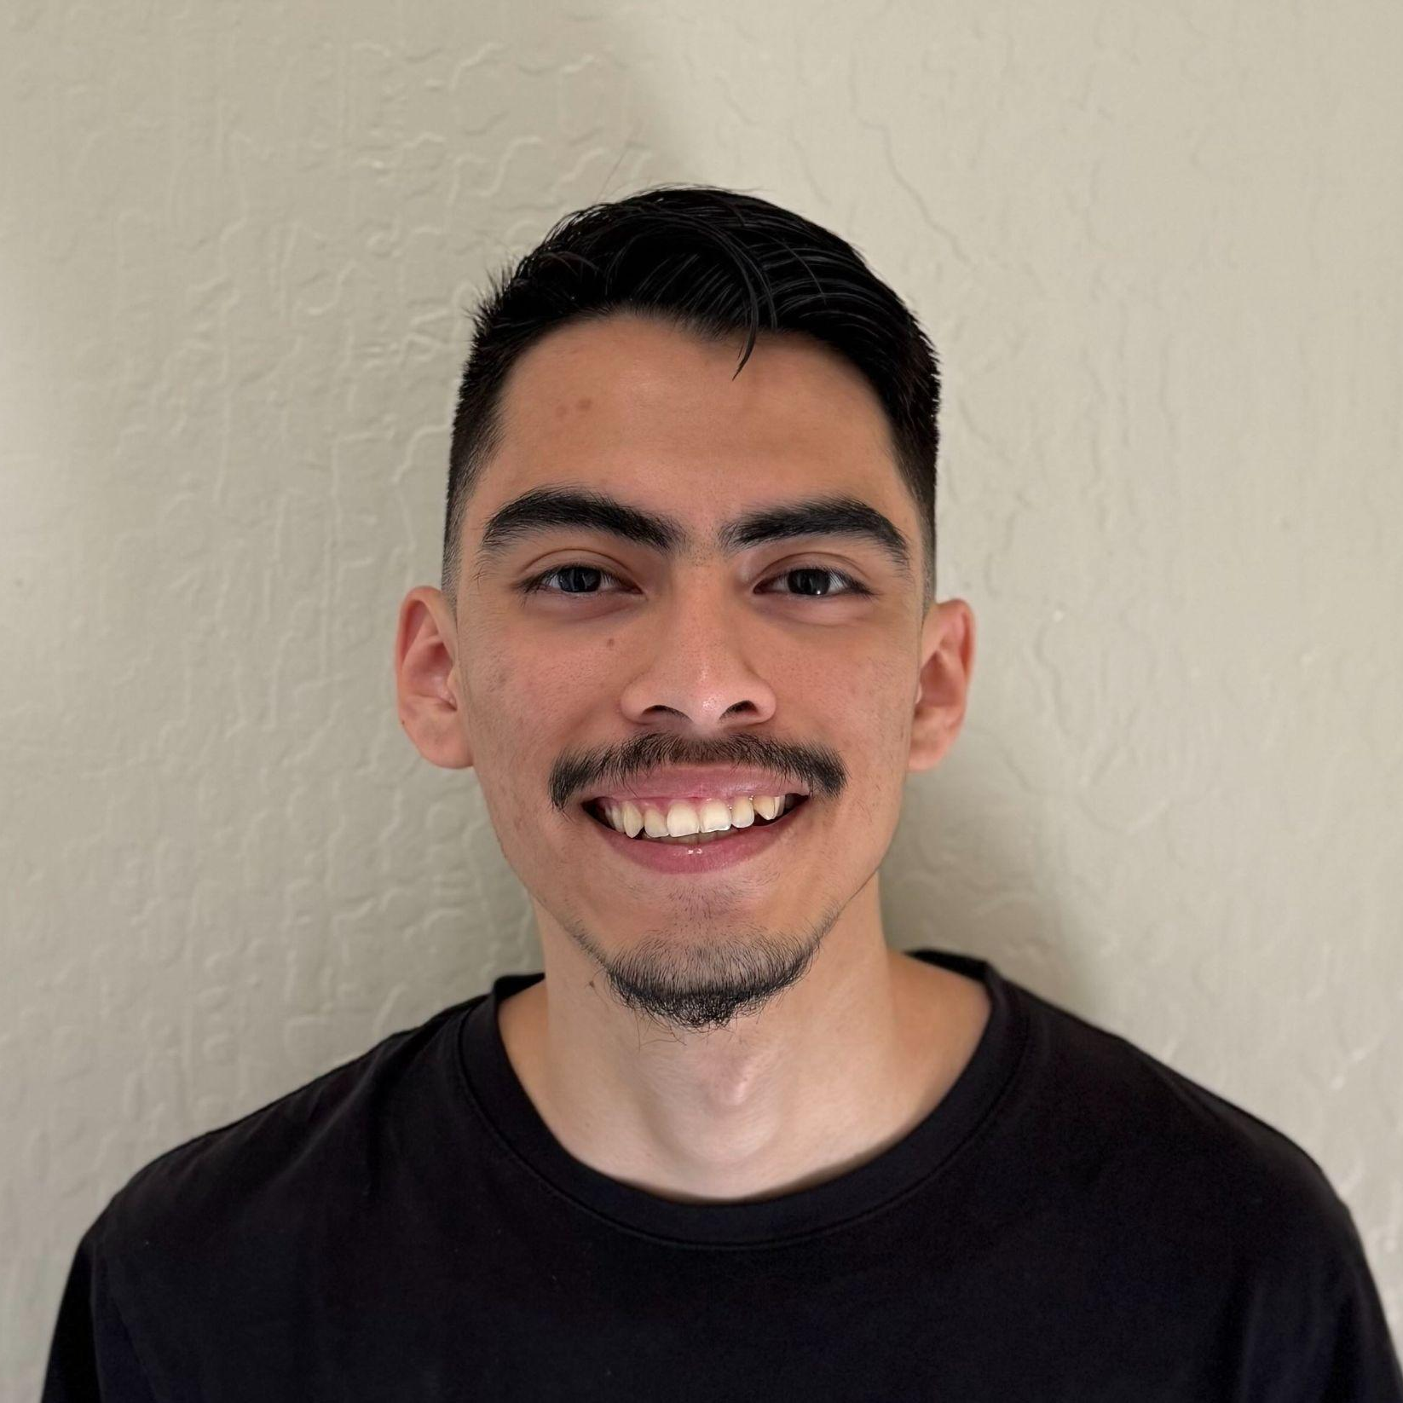


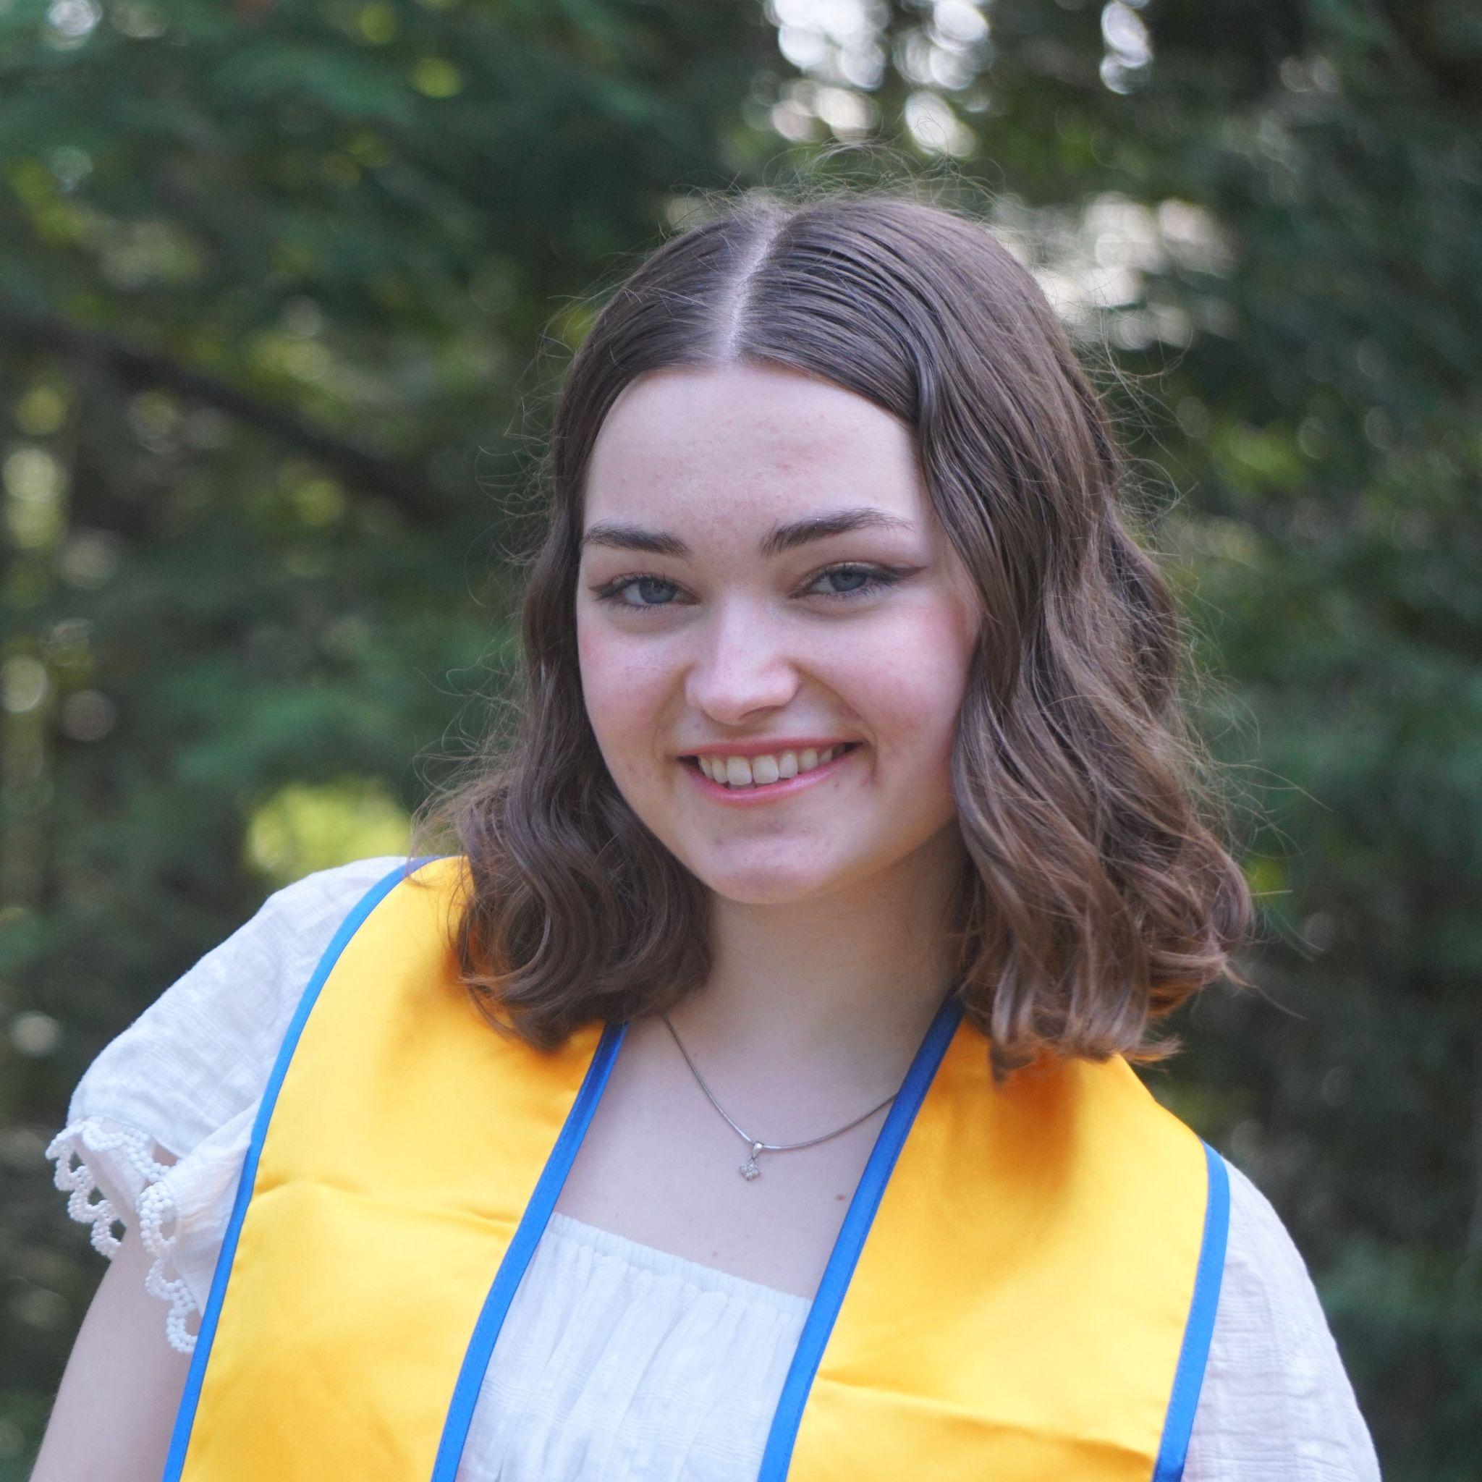


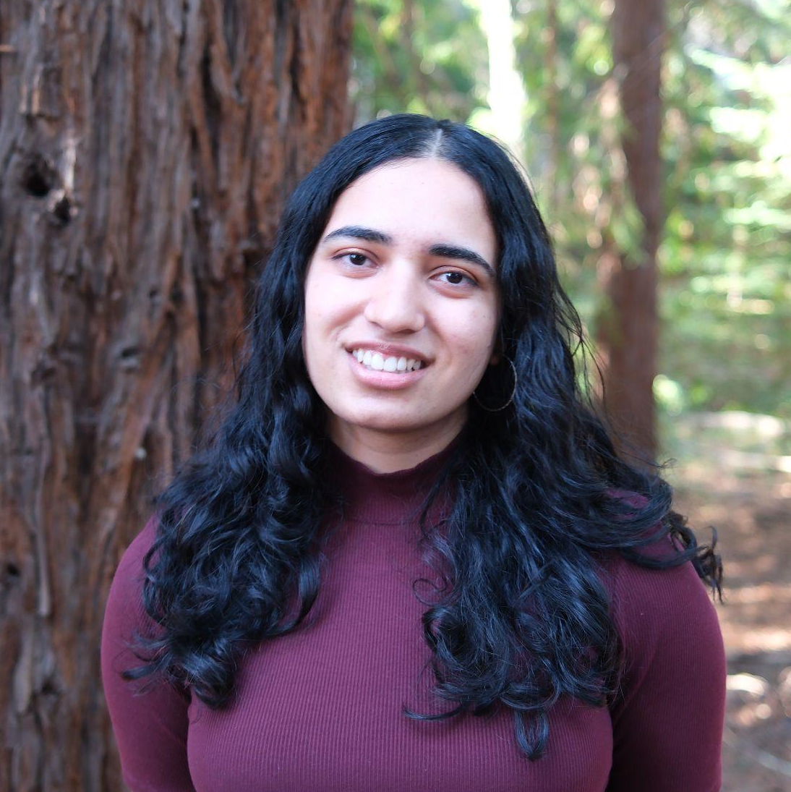
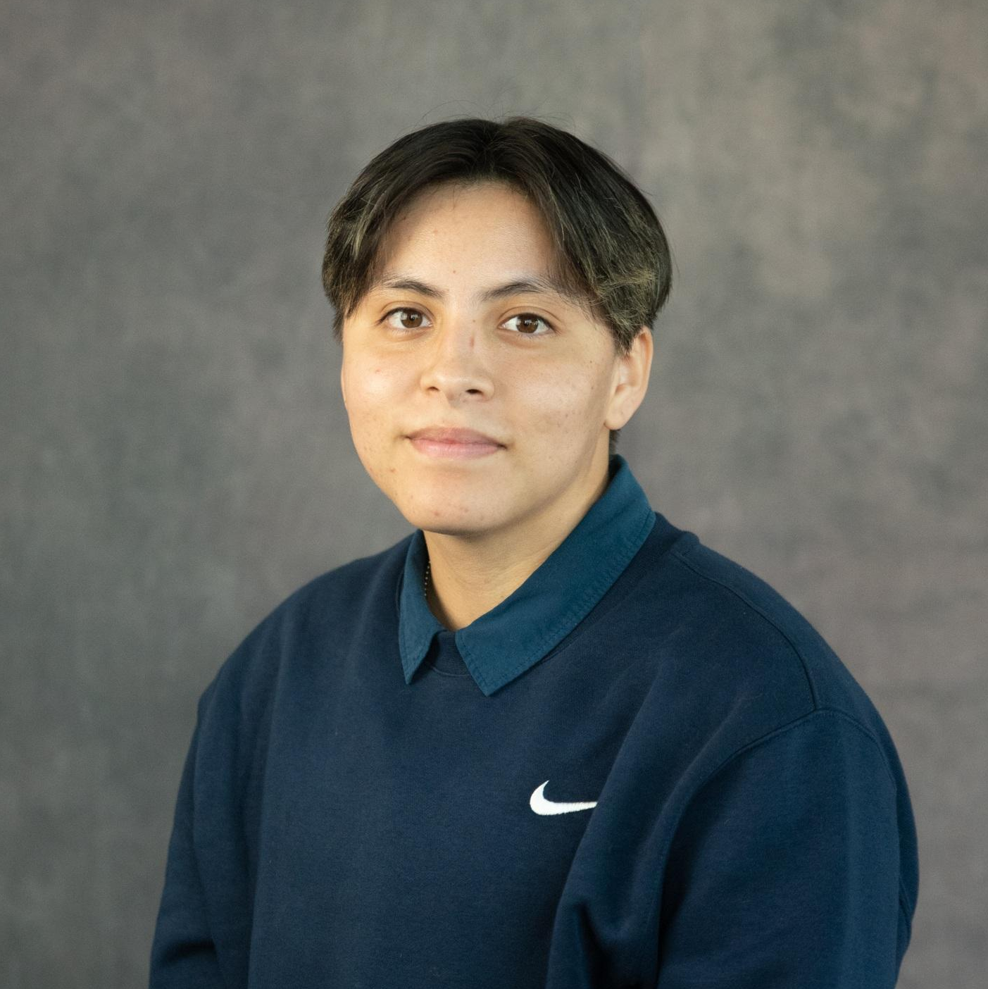
Arnav Nepal
4th year CS major
Diego Yanez
4th year CS major
Eric Phuong
4th year CS major
Navaneeth Srinivasan
4th year CS major
Sakshi Konnur
3rd year CS major
Jia Cheng Liu
3rd year CS major
Kat Kosolapova
3rd year CS major
Maggie Heathcote
4th year CS major
Simon Zhao
3rd year CS major
Violet Solorio Gaitan
4th year CS major

Slide 3

Capstone Project
CSSPP: Company-Sponsored Senior Project Program
collaboration between company and UCSC Baskin School of Engineering
CSE 115B/C
2 quarter series of classes
January - May
students assigned to sponsored projects

Slide 4
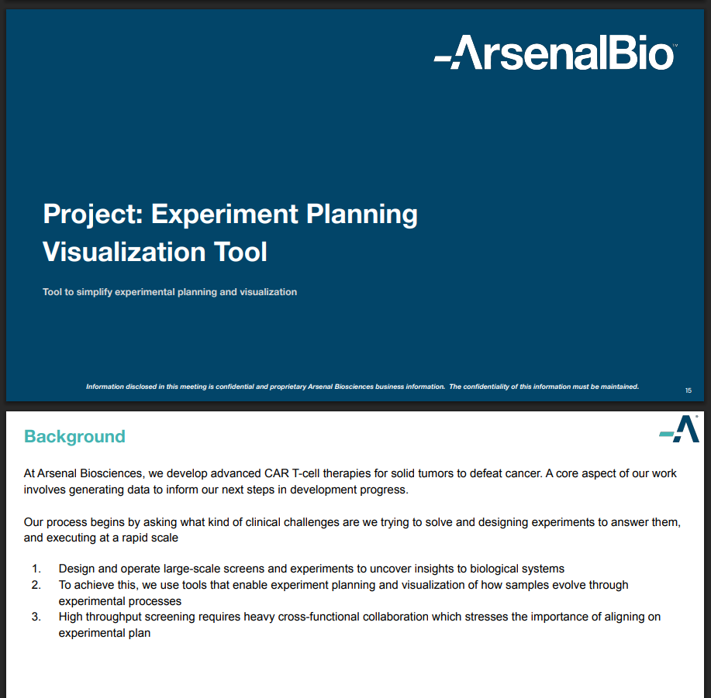
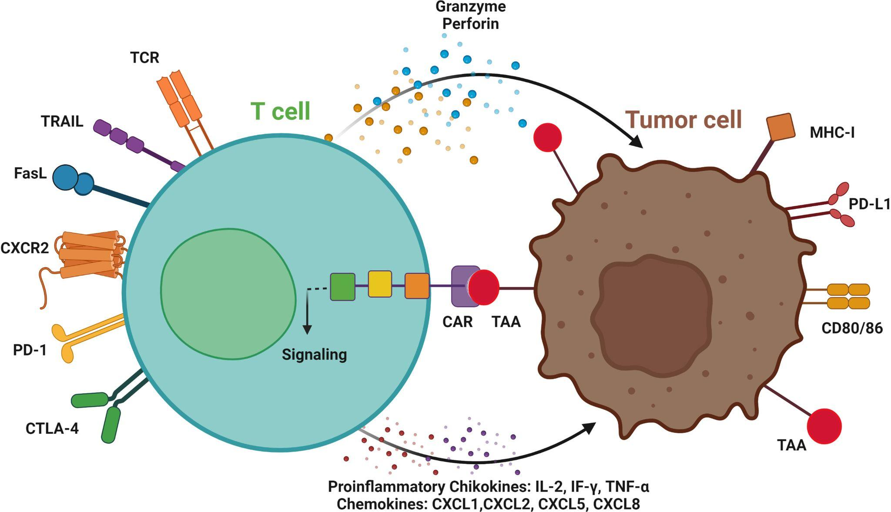
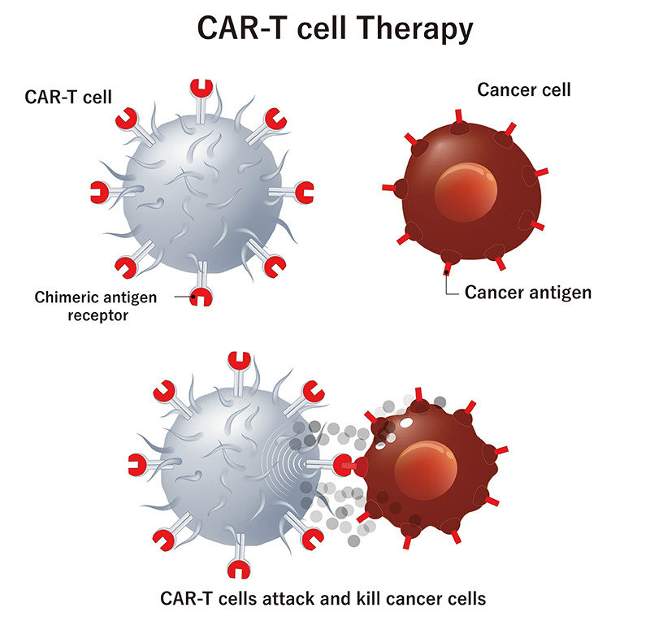
Project Pitch

Slide 5
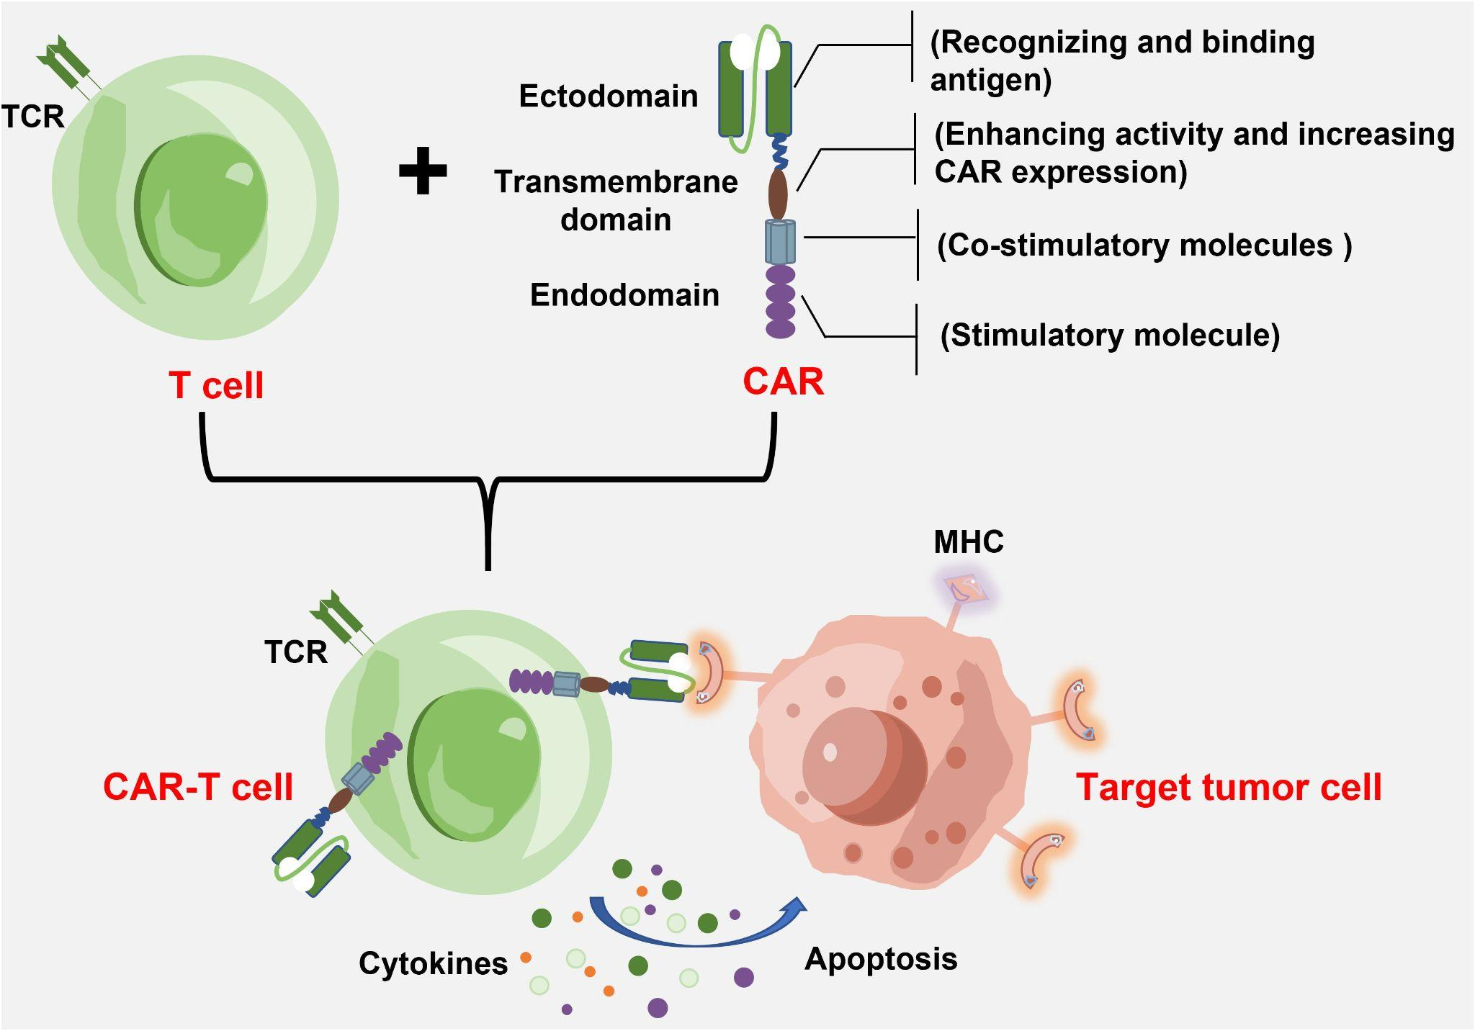
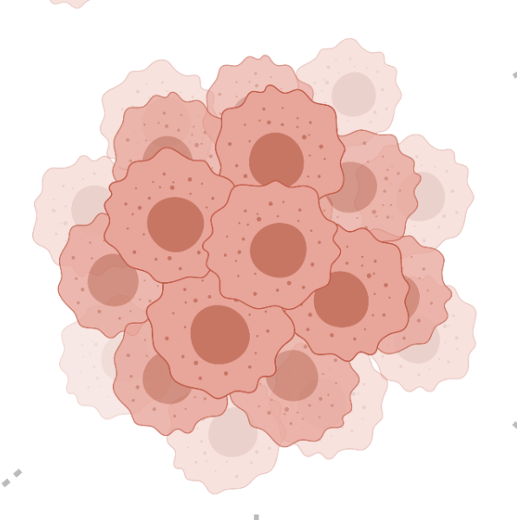
CAR T-Cell Therapy
(explain use of T cells in fighting cancer)
T-cells are key components of the immune system that use receptors on the cell’s surface to fight and kill infected or abnormal cells.
Cancer cells can resist these defenses.
How can we make T-cells that are better at killing cancer cells?

Slide 6
CAR T-Cell Therapy
(explain use of T cells in fighting cancer)
CAR T-cell therapy is one method of genetically engineering T cells to be smarter at seeking out and destroying cancer.
However, CAR T-cells are currently not potent enough to cure solid tumors.

Slide 7
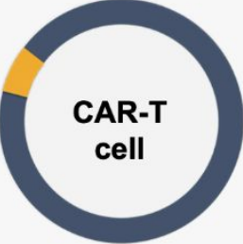
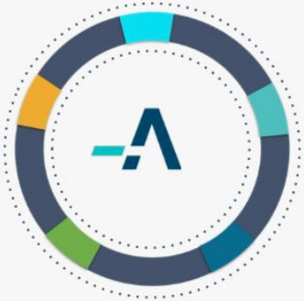
ArsenalBio
(explain ArsenalBio company goals)
“Arsenal Biosciences, Inc. is a clinical stage, programmable cell therapy company focused on solid tumor cell therapies to defeat cancer.”
Problem: Therapeutic potency limited by intrinsic T-cell biology
Solution: Reprogram T-cells to increase potency and specificity
Notes:
Ovarian and kidney cancer treatment is already in early stage clinical trials

Slide 8
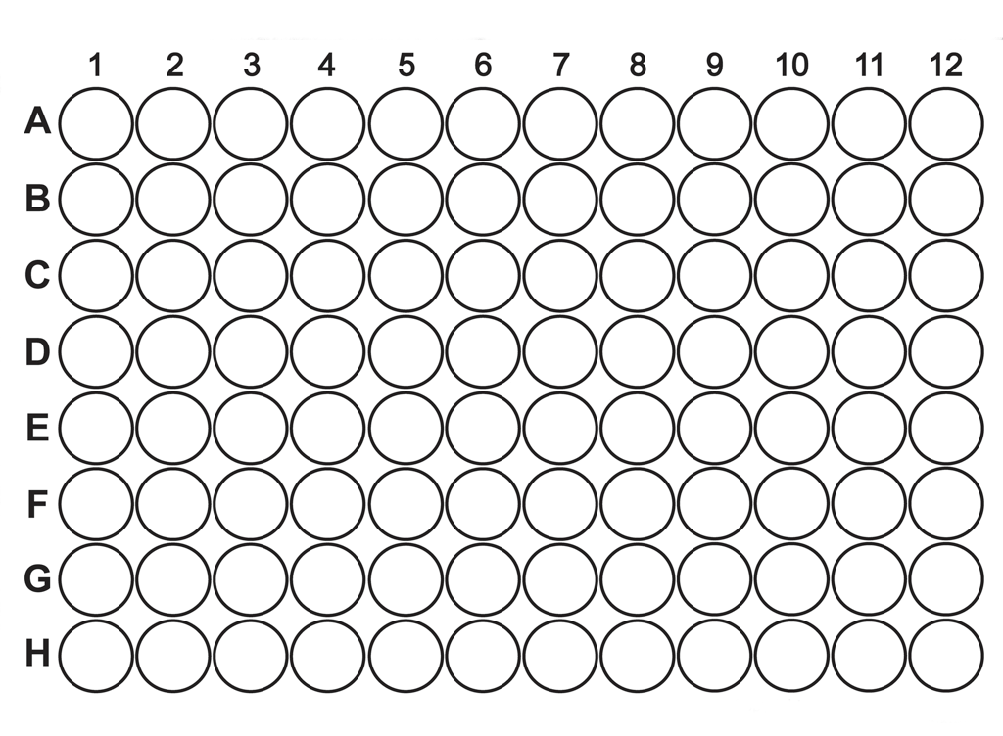
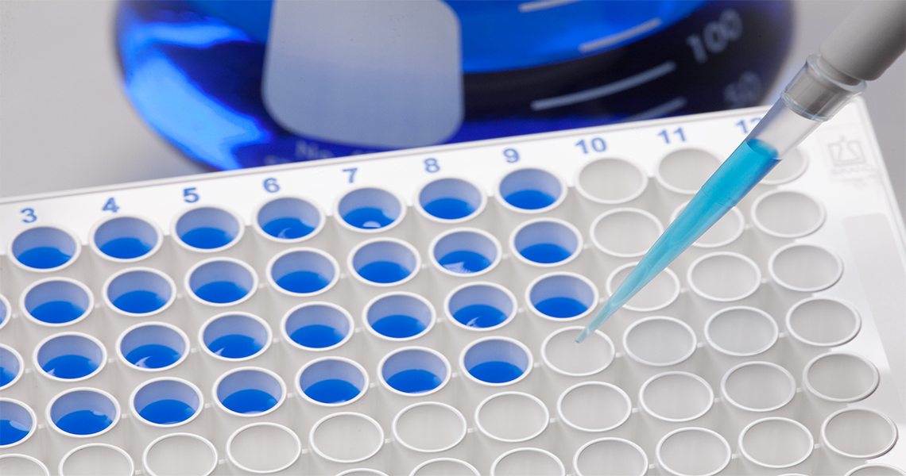
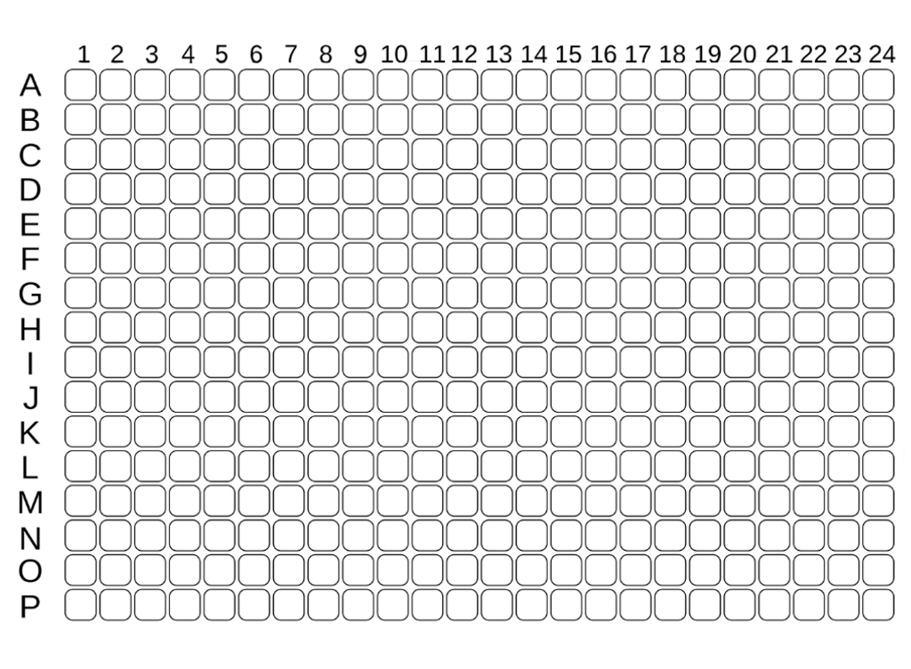
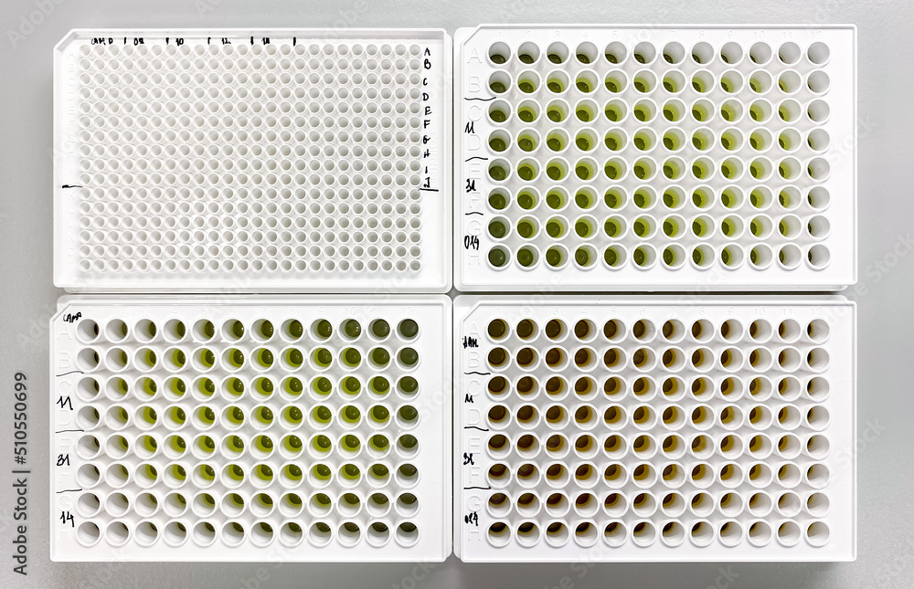
Experiment Procedure
(explain research methods involving different plates)
Scientists perform research using arrays of test samples called plates.
96 well Plate
(12x8)
These allow scientists to perform many mini experiments in parallel.
384 well Plate
(24x16)
Notes:
scientists at ArsenalBio perform research using arrays of tiny test tubes called plates
using a plate instead of individual test tubes allows scientists to run many mini experiments in parallel
by varying the inputs to each well, they can test different conditions all at once to save time and generate more data

Slide 9
Experiment Procedure
Plates travel through a series of time stages or “processes”.
Process 0
Process 1
Process 2
Process 3
(Day 0)
(Day 1)
(Day 2)
(Day 3)
Plate A
Plate A
Plate A
Plate A
Plate B
Plate B
Plate B
Plate B
Plate C
Plate C
Plate C
Plate C
Notes:
processes ~ time points in the experiment
test diff conditions/constraints

Slide 10

Experiment Procedure
From one process to another, plates may be duplicated …
Stamp
Stamp

Slide 11








Experiment Procedure
From one process to another, plates may be duplicated or consolidated.
Partial Consolidation
96w → 384w
Stamp

Slide 12
Experiment Procedure
(explain research methods involving different plates)
For each sample (biological material), scientists track a number of different conditions and attributes.
Default Attributes
May be Introduced in Later Processes
Donor ID
Plasmid
Tumor Cell Line
Media Type
Incubation Time
Metadata for a sample evolves over time.

Slide 13
Experiment Procedure
P0 Attributes
P1 Attributes
P2 Attributes
Attributes
Attributes
Attributes
Process 0
Process 1
Process 2
Prepare Cells
in Source Plate
Duplicate Source Plate
to Test Different Drugs
Measure Results
+ Drug X
Plate A.1
Plate A.1
50% of cancer
cells killed
+ Drug Y
Plate A
Plate A.2
Plate A.2
80% cancer
cells killed
+ Drug Z
Plate A.3
Plate A.3
30% cancer
cells killed
Donor ID
Plasmid
Preparation Date
. . . (prev)
Drug Type
Drug Concentration
. . . (prev)
Cytotoxicity
Viability
+ new attribute: Drug Added
Donor ID
CAR Type
Donor ID
CAR Type
Donor ID
CAR Type
Notes:
Cytotoxicity measures how effectively CAR-T cells kill target cancer cells.

Slide 14
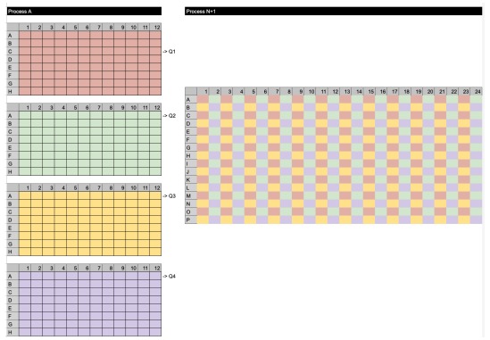
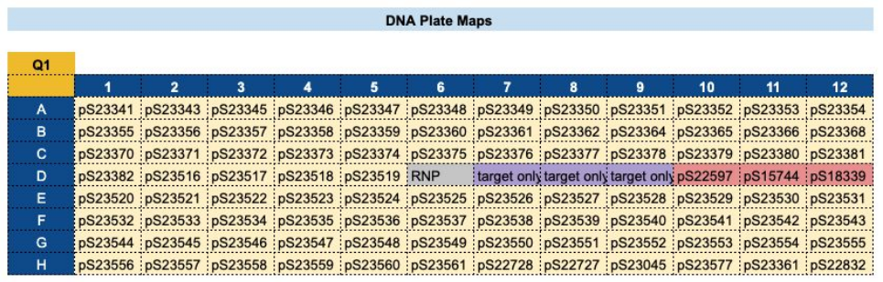
The Problem
(explain current methods of visualization / sharing)
Current methods of visualizing planned experiments are: Manual and Time Consuming.
Using Google Suite/Benchling Notebooks to track conditions and properties.
Using Lucidchart to manually draw plates and connect relationships.

Slide 15
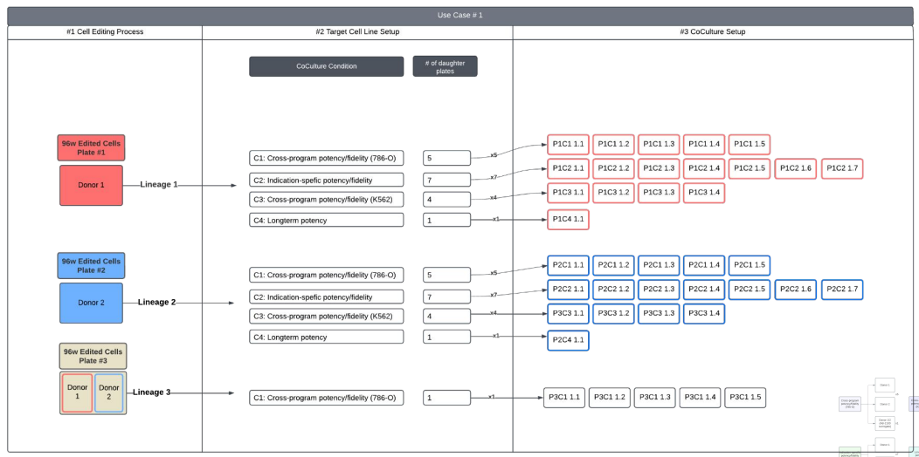
The Problem
(explain current methods of visualization / sharing)
Current methods of visualizing planned experiments are: Inefficient for Scaling.
Increasingly challenging and error prone as the number of experimental conditions, plates, and samples grow.

Slide 16
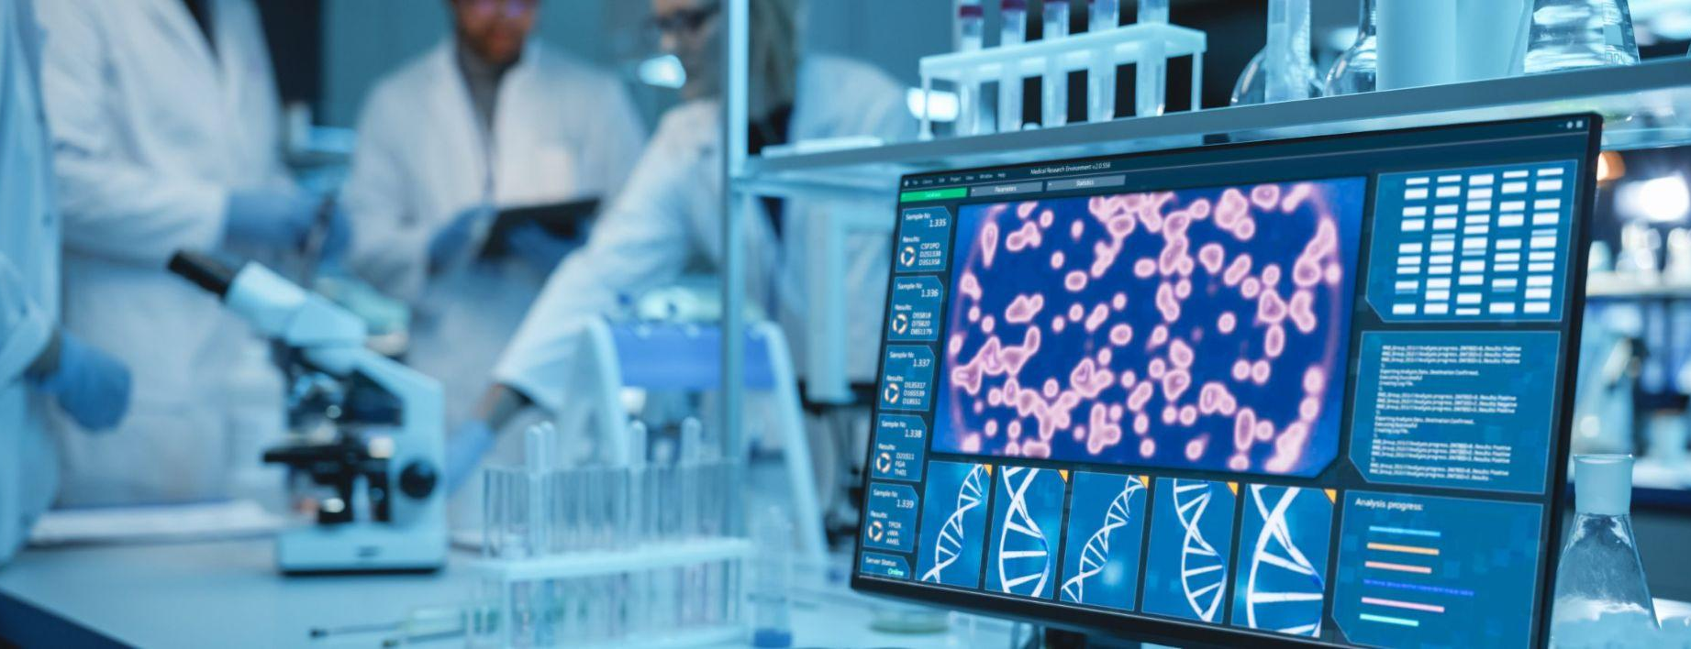
The Solution
(explain the tool we aim to create and how it will be used)
We aimed to create a tool that scientists can use to plan and visualize their experiments without solely relying on manual data entry.
We aim to create a tool that scientists can use to plan and visualize their experiments without solely relying on manual data entry.

Slide 17
Project Goals
Plate Visualization
Condition Tracking
Lineage Tracking
interactive interface to visualize 96W/384W plates
track attributes and properties of plates and wells
visualize plate relationships as they move through processes

Slide 18
Project Goals
Data Importation
Automation
Collaboration
preload experiment and plate data by uploading CSV files
automate repetitive tasks to reduce errors and save time
programs & teams, sharing, and viewing changes in an audit log

Slide 19
Demo

Slide 20
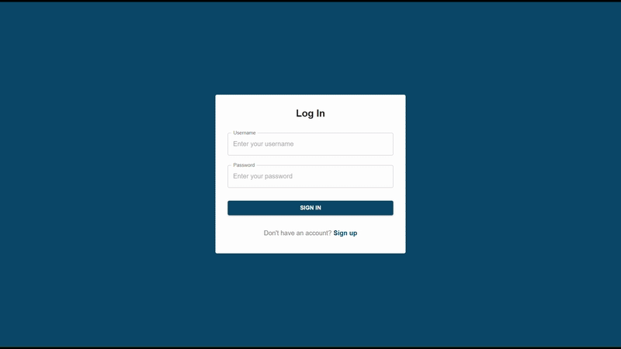
Login
Notes:
Our site is protected with authentication and requires your typical login system. Users can also register for an account at this step.

Slide 21
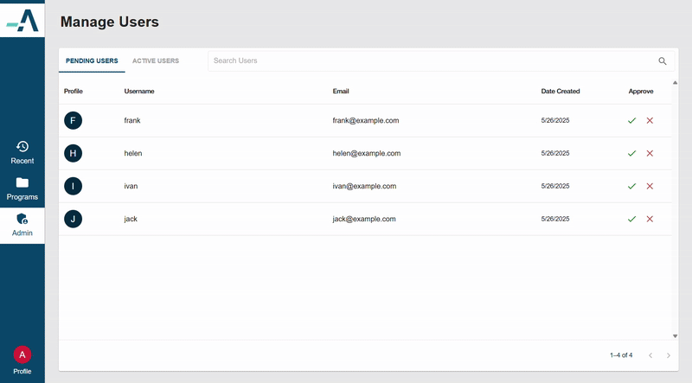
Admin Controls
Notes:
An admin needs to approve of newly registered users before they get access to the site. Admins can also deactivate current active users.

Slide 22
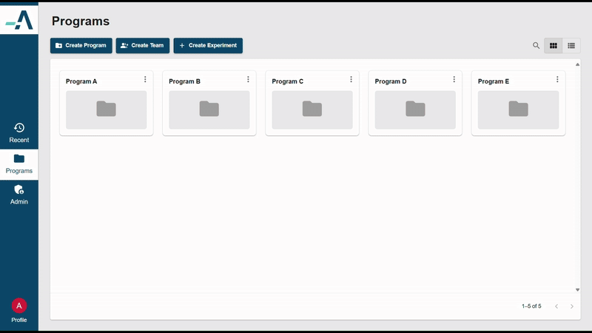
Dashboard
Notes:
The dashboard contains programs, teams which are nested under programs, and finally experiments which are nested under teams. There is also grid and list view. This folder like structure helps organize the large amounts of experiments ArsenalBio will have.

Slide 23
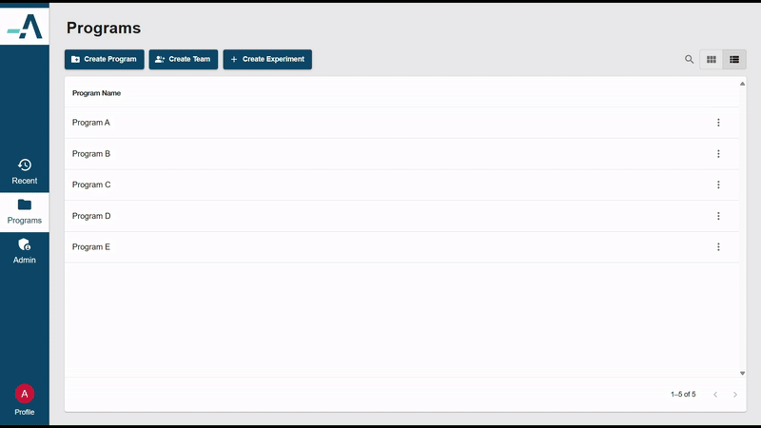
Recents

Slide 24
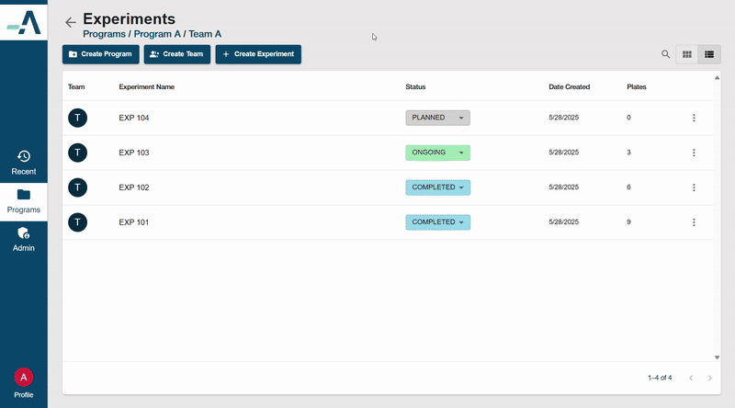
Create Experiment
Notes:
There are two ways to create an experiment. You can select manual entry which will create an empty experiment or you can upload data from a csv which will preload that data into an experiment. For this demo we’ve chosen manual entry.

Slide 25
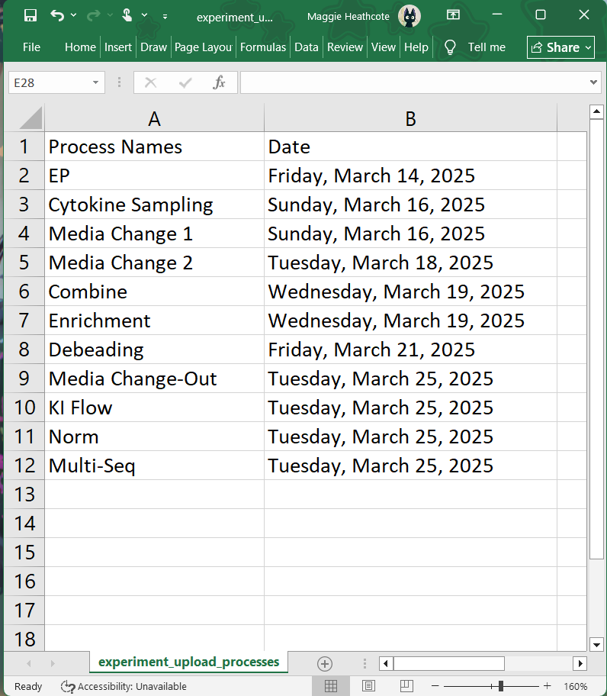
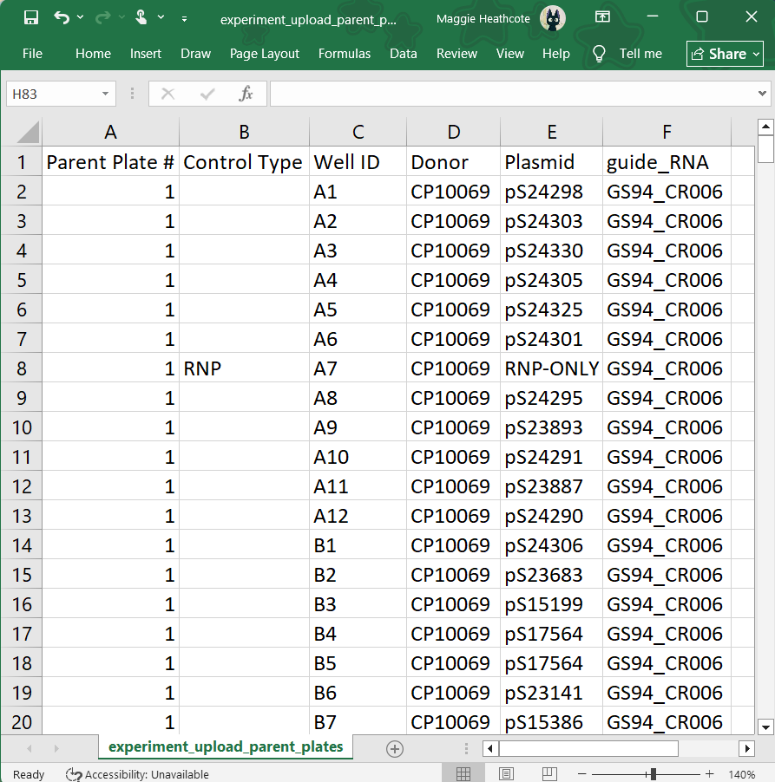
Upload Experiment

Slide 26
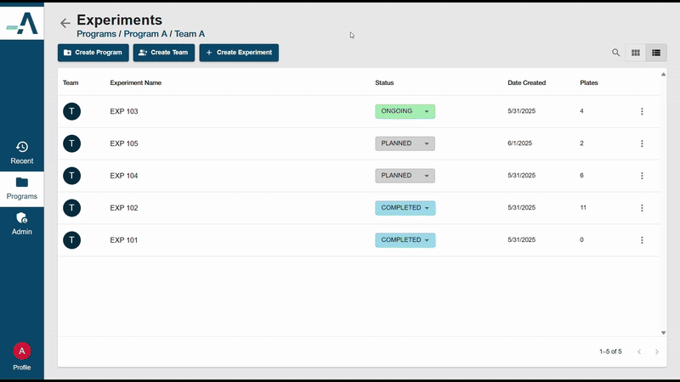
Upload Experiment

Slide 27
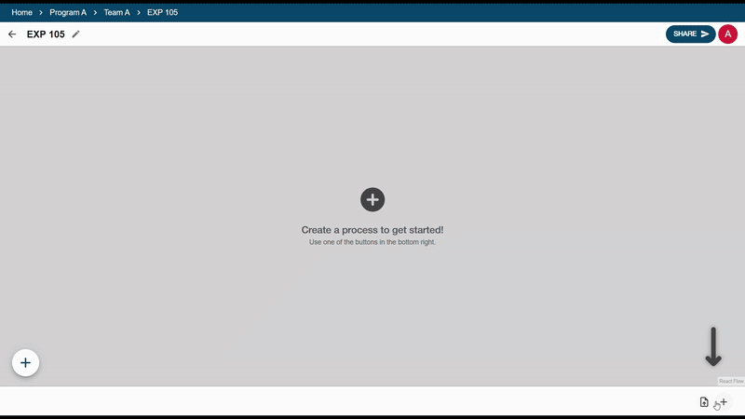
Create Process

Slide 28
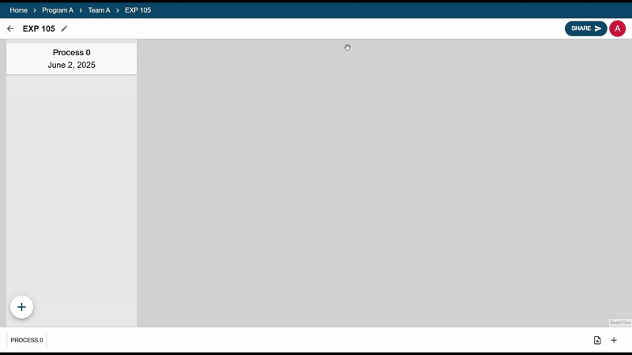
Create Plates

Slide 29
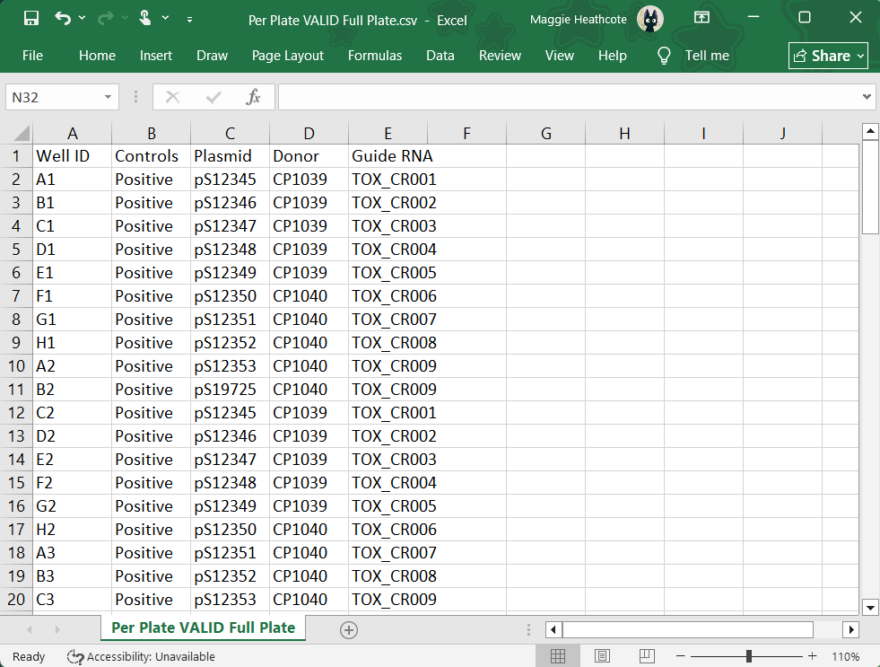
Upload Plate

Slide 30
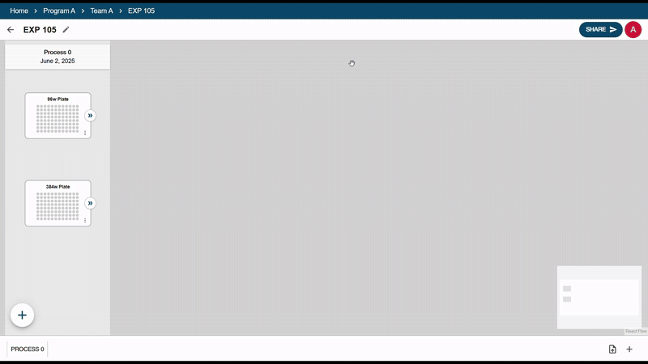
Upload Plate

Slide 31
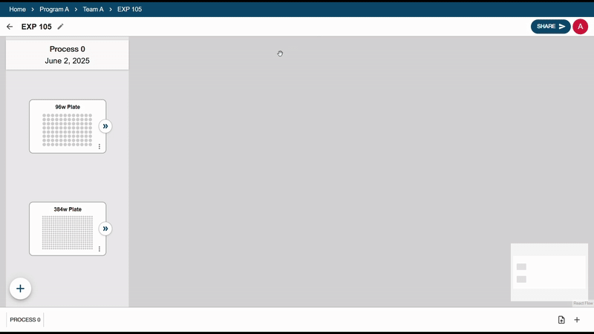
Entering Plate View

Slide 32
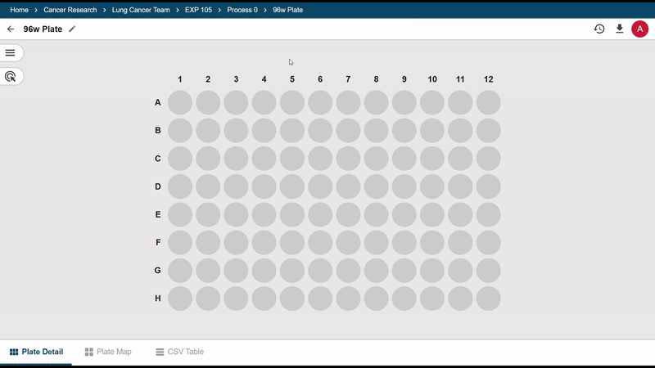
Creating Well Groups

Slide 33
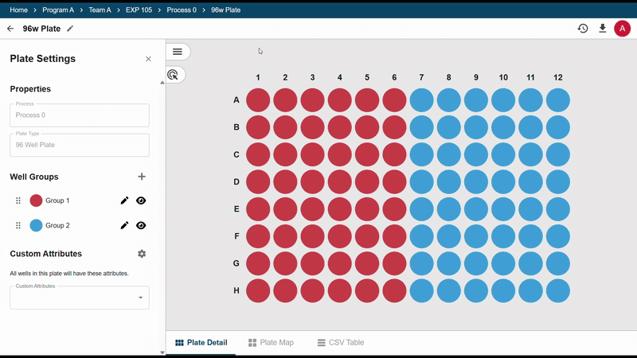
Custom Attributes

Slide 34
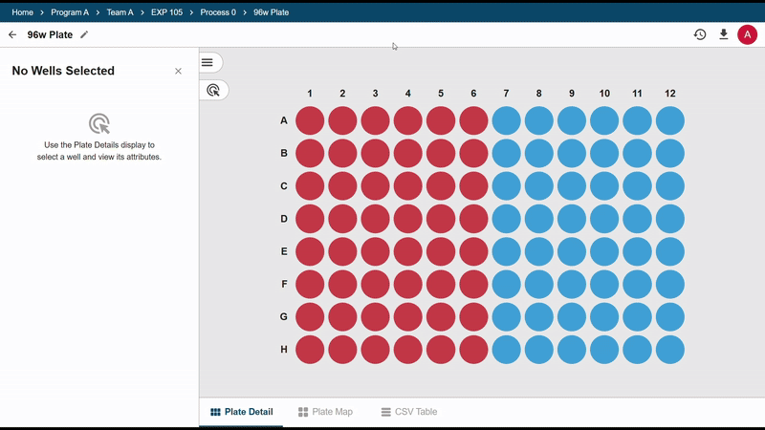
Editing Attributes

Slide 35
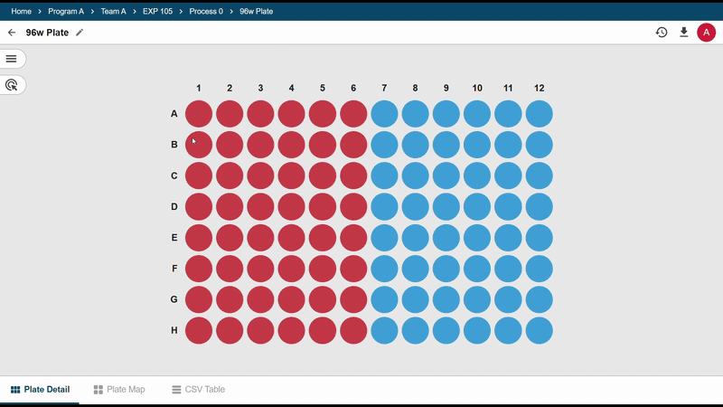
Table Views

Slide 36
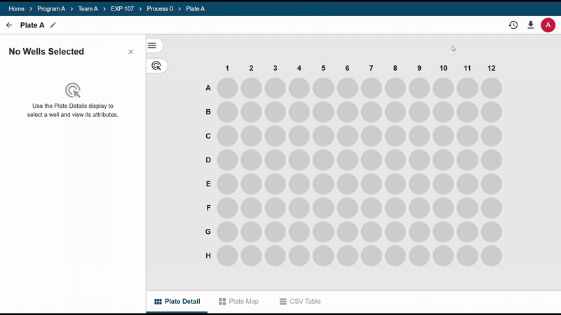
Audit Log

Slide 37
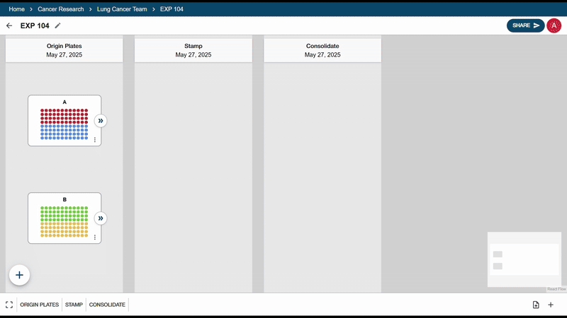
Forward Branch
Notes:
In exp view, we also have forward branch actions

Slide 38
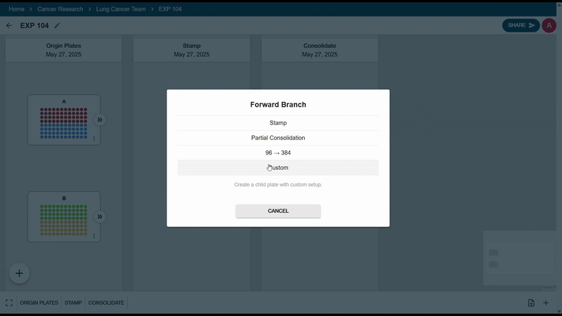
Forward Branch: Stamp
Notes:
In exp view, we also have forward branch actions

Slide 39
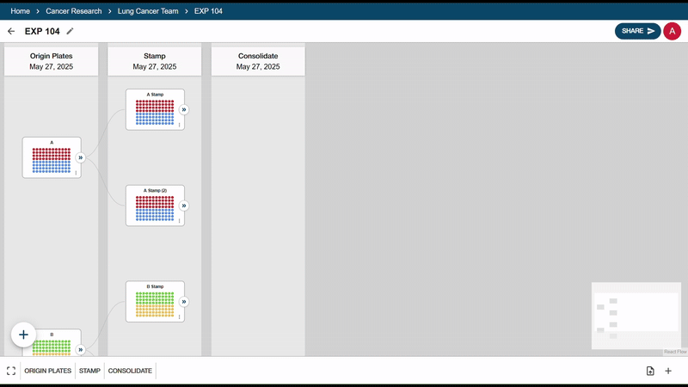
Forward Branch: Partial Consolidation

Slide 40
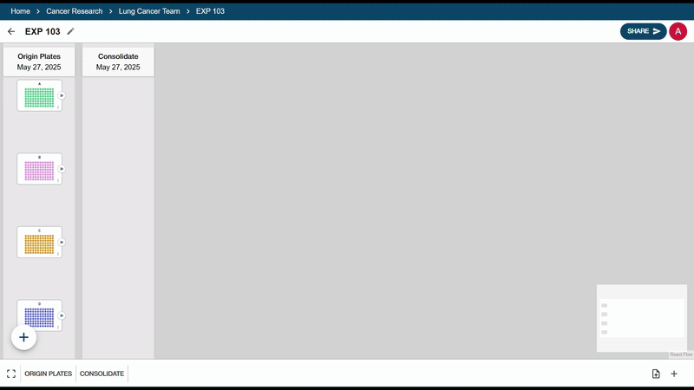
Forward Branch: 96 to 384
Notes:
96-to-384 combine 4 96wp to 384wp We can decide which of the 4 quadrants we want to assign each plate to

Slide 41
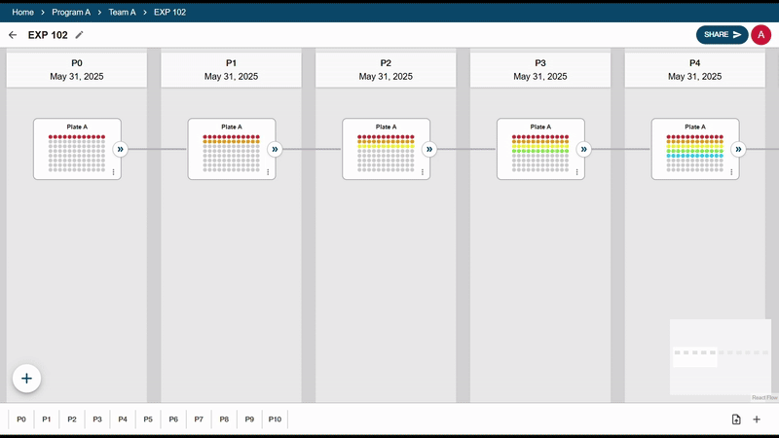
Navigating the Canvas

Slide 42
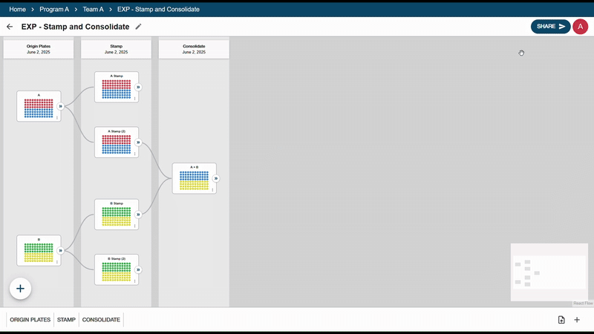
Export and Share

Slide 43
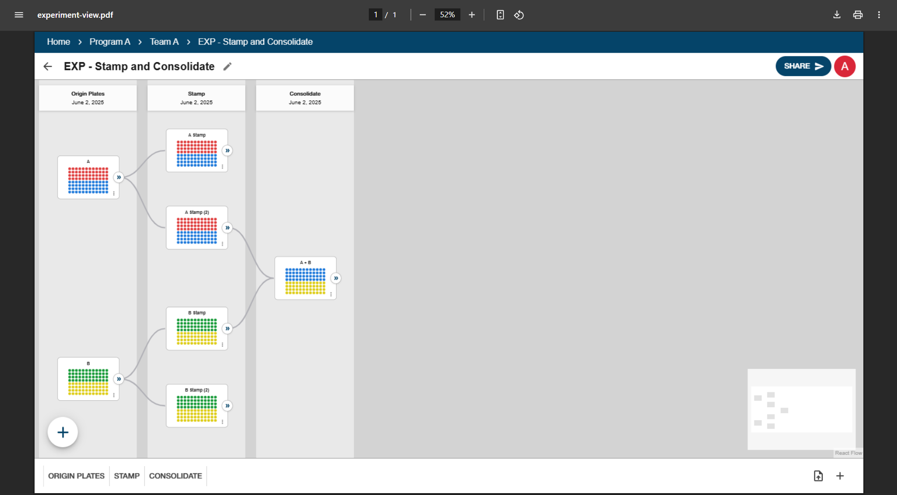
Export and Share

Slide 44






Architecture
tt
Arsenal Bio VPC
Amazon ECS Cluster
Web Server
Amazon ALB
Load Balancer
Client
Amazon RDS
API
Server
Database
Notes:
Runs AWS
client access the load balancer through url

Slide 45
Challenges
Understanding the Project
Technology & Tools
Unfamiliar with BioTech
Significant list of goals
New coding languages
Technology constraints
Development
Team Management
Deployment issues
Testing
Large team
Schedule conflicts

Slide 46
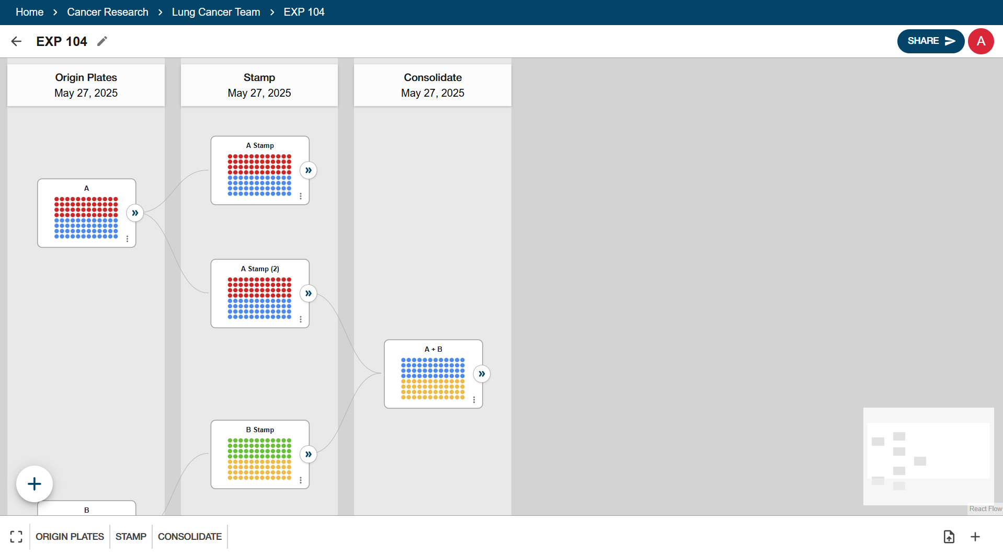
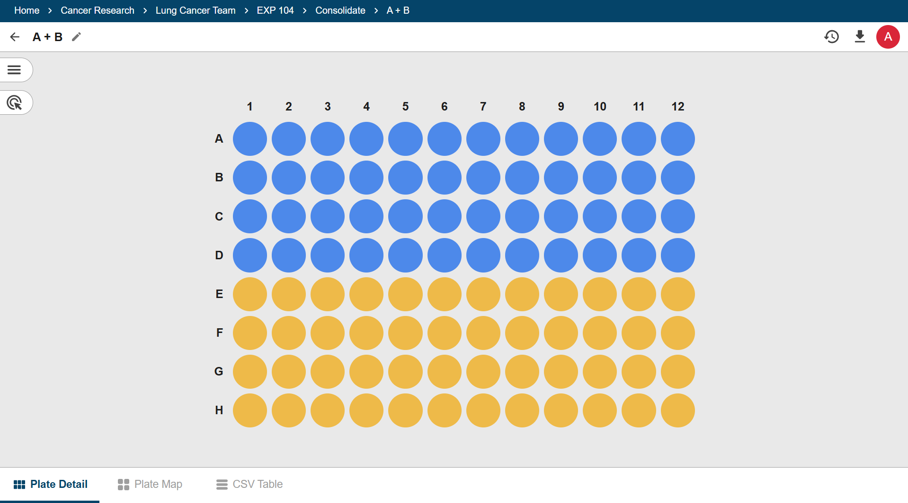
Approach
We formed 2 sub-teams to each focus on a portion of the tool.
Experiment Team
Plate Team
Login & Dashboard
Experiment Management
Experiment Canvas
Process Columns
Plate Nodes
Plate View
Colored Well Groups
Data Tables
Attribute Tracking
Creating Child Plates

Slide 47
Release 1 Results
(summarize achievements/contributions so far)
(address how the goals of the project have changed)
hosted project
CSV file import
unit testing
base frontend pages and components
database structure
Sprint 1
Sprint 3
researching
planning
designing
Sprint 2
CRUD operations on plate
selectable plate wells
experiment view canvas setup
Sprint 4

Slide 48
Release 2 Results
(state objectives for release 2)
(timeline)
CRUD operations on dashboard
plate nodes on experiment view
well group creation
create child plates from parent
audit log
buttons to change canvas view
Sprint 6
Sprint 8
Sprint 5
PDF file export
automatic plate layout on canvas
view plate data as a spreadsheet
Sprint 7
final testing and documentation
wrap up project
present end-product

Slide 49

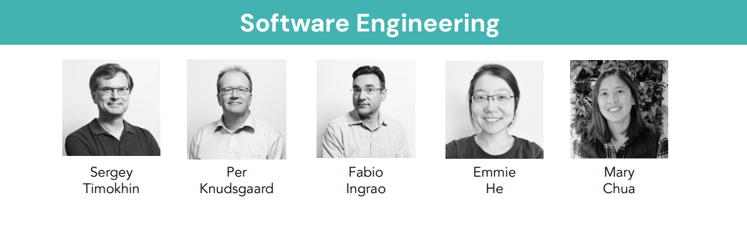
Future of the Project
We will be handing off our work to the ArsenalBio Software Engineering team, who will maintain the platform and continue development based on feedback from scientists.

Slide 50

Acknowledgement
Special thanks to:
The Software Team
Fabio Ingrao
Mary Chua
The Staff
Instructor Richard Jullig
TA Pranay Mundra

Slide 51
Thank You
Any Questions?

